Slide 1
File Input and Output
Appendix E
© 2015 Pearson Education, Inc., Hoboken, NJ. All rights reserved

Slide 2
Why Files?
We do not want output of program to disappear when program execution stops.
  We need data to last, to be persistent
Files provide a convenient way to deal with large data sets
A program can create a file for its own use as temporary storage
© 2015 Pearson Education, Inc., Upper Saddle River, NJ. All rights reserved

Slide 3
Streams
In Java, all input and output of data involves streams
  This includes files
A stream is an object that represents a flow of data
Example: object System.out an output stream that moves data from program to display
Must connect a file to appropriate stream and associate it with Java program
© 2015 Pearson Education, Inc., Upper Saddle River, NJ. All rights reserved

Slide 4
Kinds of Files
Java treats files as either text files or binary files
  Text file represents a collection of characters
  Any file other than a text file is called a binary file
Use text file a text editor will be used to access the file
Binary files typically require less disk space than text files
© 2015 Pearson Education, Inc., Upper Saddle River, NJ. All rights reserved

Slide 5
File Names
Java does not specify characters that can make up a file name …
  But your operating system does
Typically, you use
  Letters and digits
  A dot in the name of a data file,
  Ending it with a suffix, such as .txt
© 2015 Pearson Education, Inc., Upper Saddle River, NJ. All rights reserved

Slide 6
Creating a Text File
A text file contains a sequence of characters
  Each character is represented by the system’s default encoding.
Java uses Unicode character set
Typical text file is organized as lines
  Each ending with a special end-of-line character
The file is a sequence of data
  Offers sequential access to its contents
© 2015 Pearson Education, Inc., Upper Saddle River, NJ. All rights reserved

Slide 7
Creating a Text File
Before you can write to a text file, you must open it
PrintWriter’s constructor creates an output stream called toFile
  Connects it to the file named by the String variable fileName
  Text file created is initially empty
  If fileName existed before, its contents are lost
© 2015 Pearson Education, Inc., Upper Saddle River, NJ. All rights reserved

Slide 8
Creating a Text File
Print Writer's constructor can throw a checked exception
Its invocation must appear within either
  try block that is followed by an appropriate catch
  Or a method whose header lists this exception in a throws clause.
FileNotFoundException will occur if file cannot be opened for output, either because
  It does not exist and cannot be created
  Or it is inaccessible.
© 2015 Pearson Education, Inc., Upper Saddle River, NJ. All rights reserved

Slide 9
Writing to a Text File
Methods println and print of the class PrintWriter work the same for writing to a text file
  As those of System.out.
Note: output from println or print not sent to output file right away
  Saved and placed into portion of memory called a buffer
  When buffer is full, contents written to the file
© 2015 Pearson Education, Inc., Upper Saddle River, NJ. All rights reserved

Slide 10


Writing to a Text File
When finished using a file, must disconnect it from the stream
  Data in buffer sent to file, file resources released
Can force pending output currently in buffer to be written to destination file
© 2015 Pearson Education, Inc., Upper Saddle River, NJ. All rights reserved

Slide 11
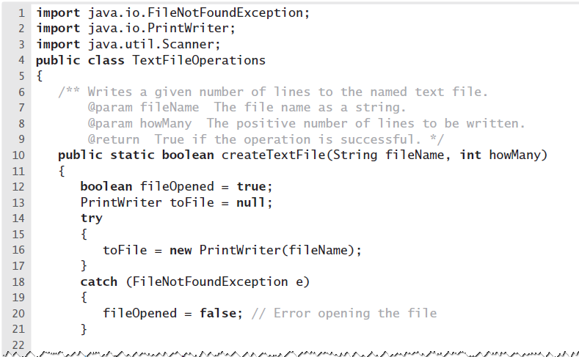
Writing to a Text File
LISTING E-1 The static method createTextFile
in the class TextFileOperations
© 2015 Pearson Education, Inc., Upper Saddle River, NJ. All rights reserved

Slide 12
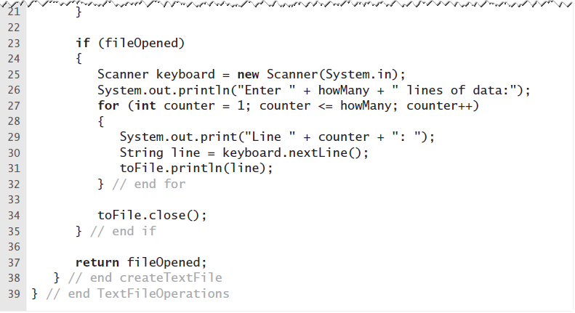
Writing to a Text File
LISTING E-1 The static method createTextFile
in the class TextFileOperations
© 2015 Pearson Education, Inc., Upper Saddle River, NJ. All rights reserved

Slide 13
Appending to a Text File
Use class FileWriter
  Constructor opens file with append option
Constructors of both FileWriter and PrintWriter can throw an exception,
  We invoke them within a try block
© 2015 Pearson Education, Inc., Upper Saddle River, NJ. All rights reserved

Slide 14
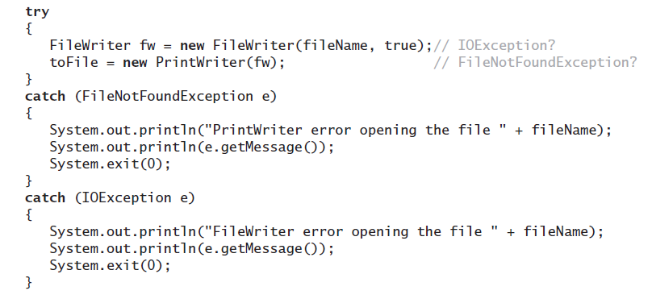
Appending to a Text File
Opening file with try and catch
© 2015 Pearson Education, Inc., Upper Saddle River, NJ. All rights reserved

Slide 15
Reading a Text File
Invoke Scanner’s constructor to open a file for input.
  Use File’s constructor to open a text file
This constructor can throw a FileNotFoundException
© 2015 Pearson Education, Inc., Upper Saddle River, NJ. All rights reserved

Slide 16
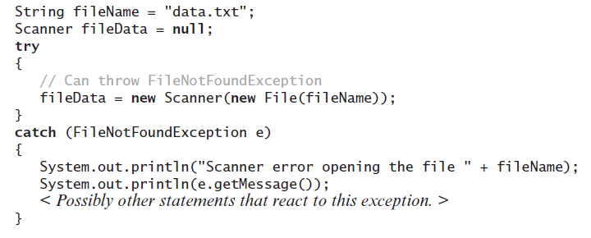
Reading a Text File
Opening the text file named data.txt for input
© 2015 Pearson Education, Inc., Upper Saddle River, NJ. All rights reserved

Slide 17
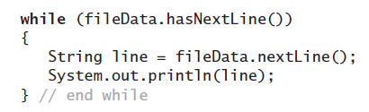
Reading a Text File
If you do not know format of the data in file,
  Use the Scanner method nextLine to read it line by line.
© 2015 Pearson Education, Inc., Upper Saddle River, NJ. All rights reserved

Slide 18
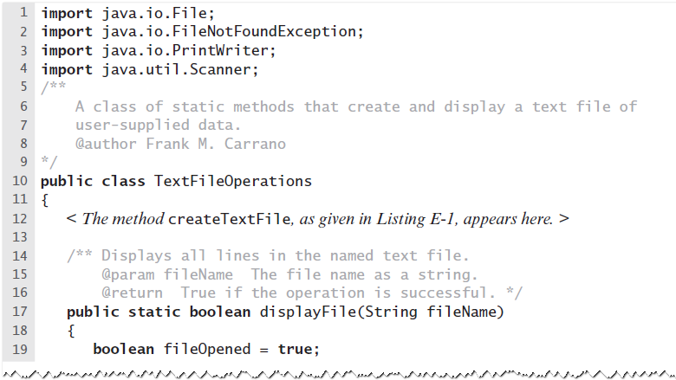
Reading a Text File
LISTING E-2 The static method displayFile
in the class TextFileOperations
© 2015 Pearson Education, Inc., Upper Saddle River, NJ. All rights reserved

Slide 19
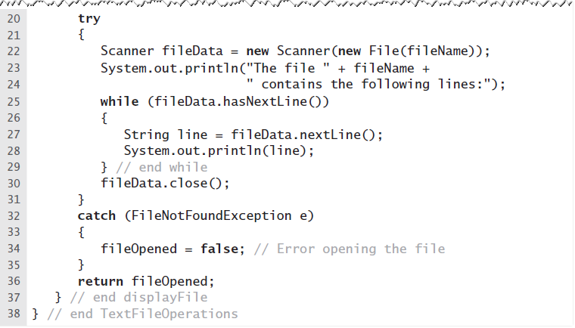
Reading a Text File
LISTING E-2 The static method displayFile
in the class TextFileOperations
© 2015 Pearson Education, Inc., Upper Saddle River, NJ. All rights reserved

Slide 20
File Input and Output
End
© 2015 Pearson Education, Inc., Upper Saddle River, NJ. All rights reserved

